Slide 1
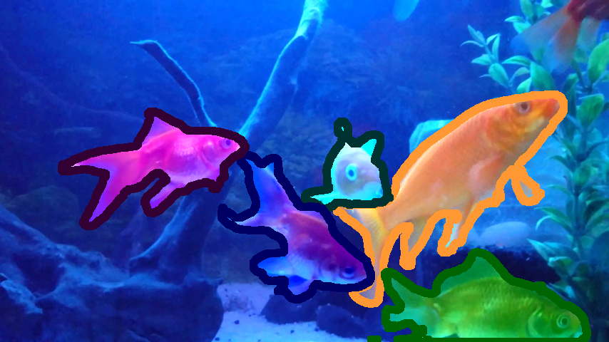
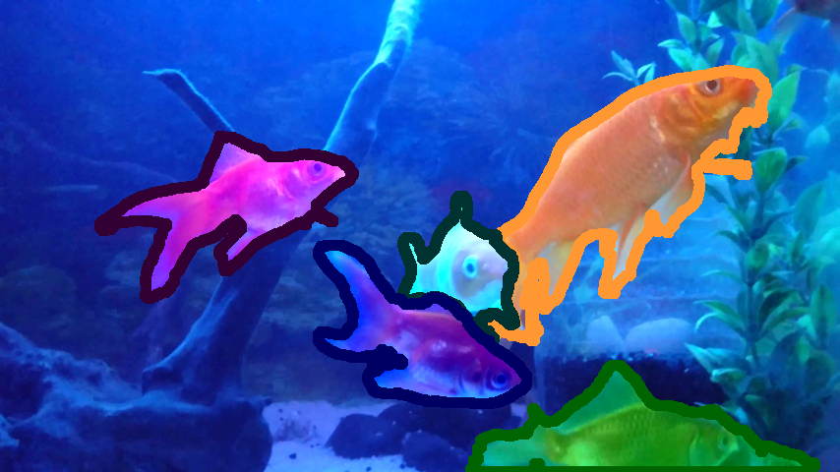

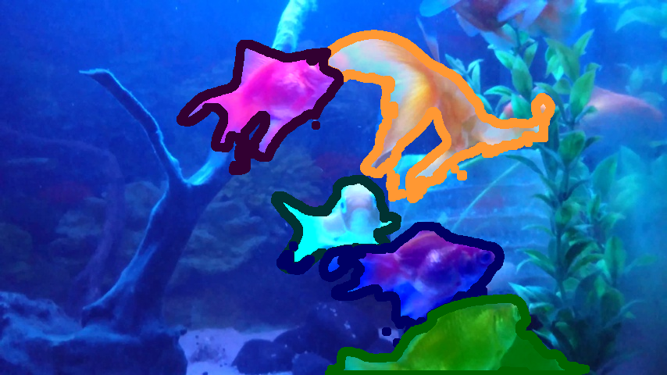
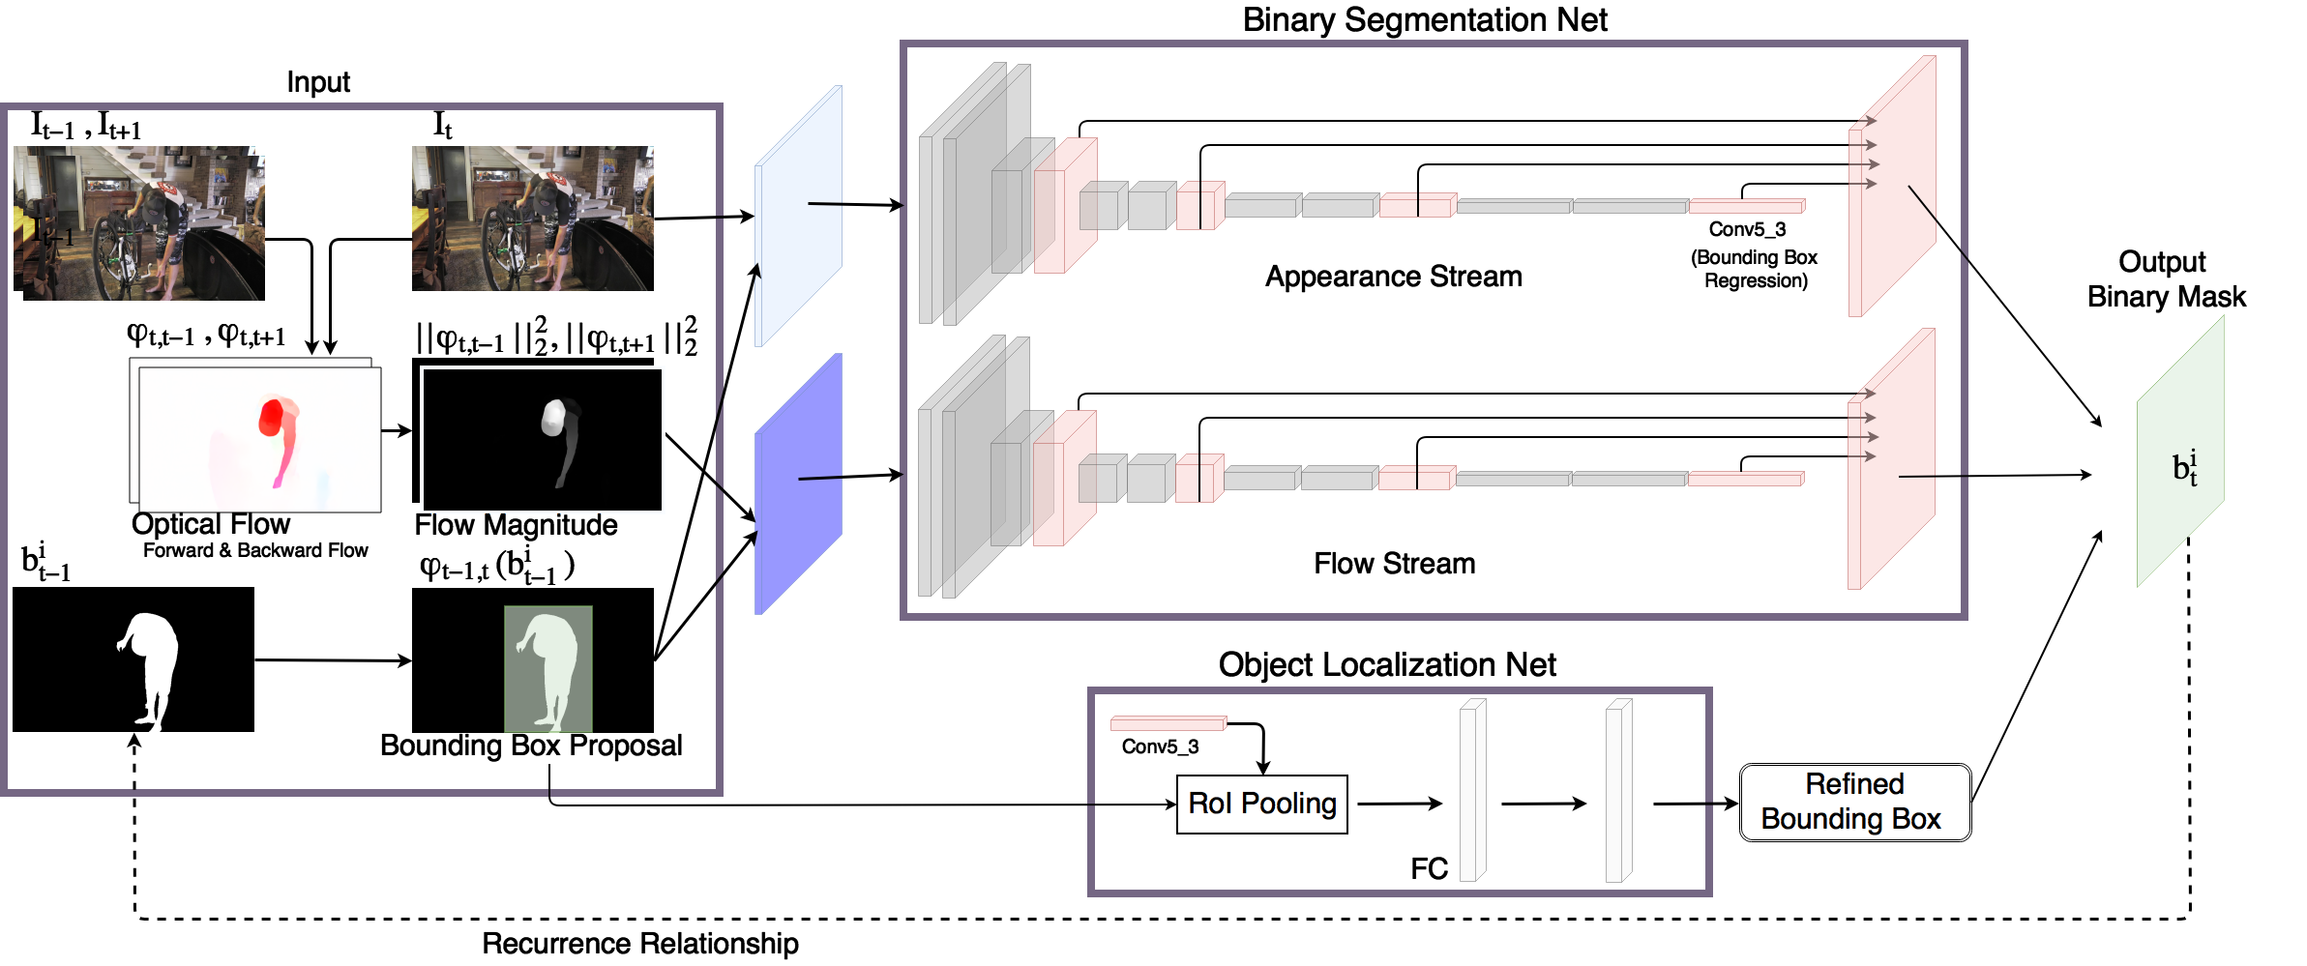
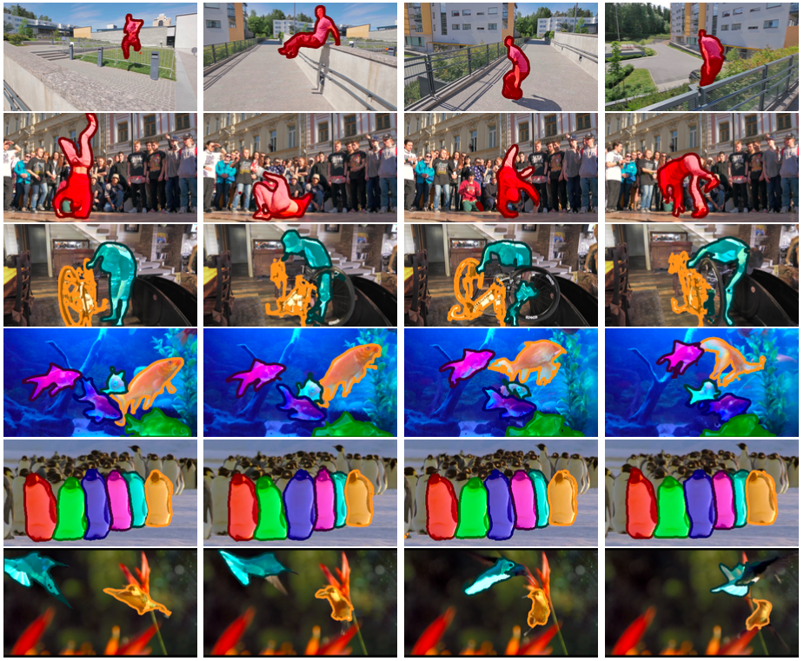
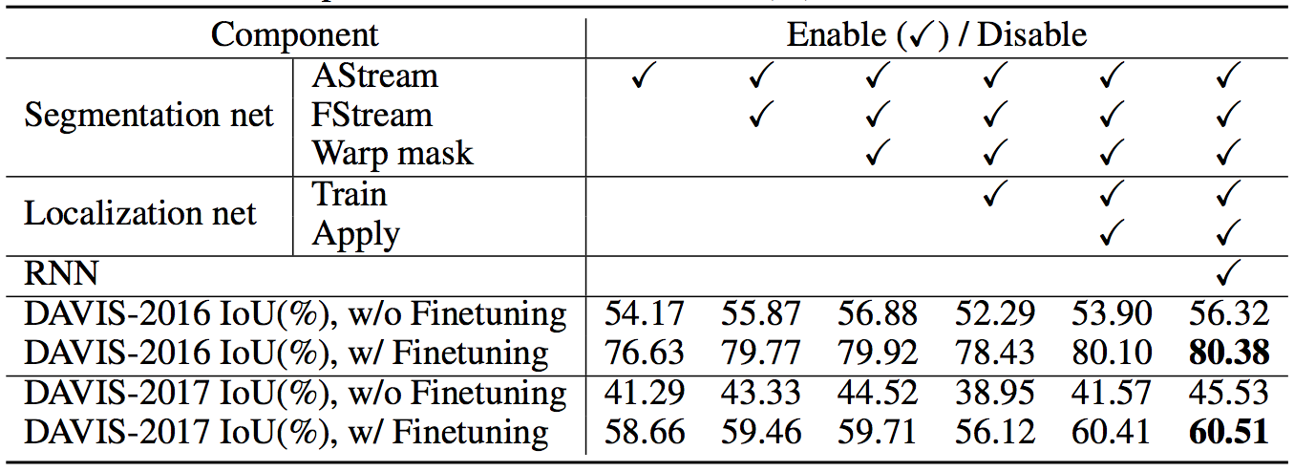
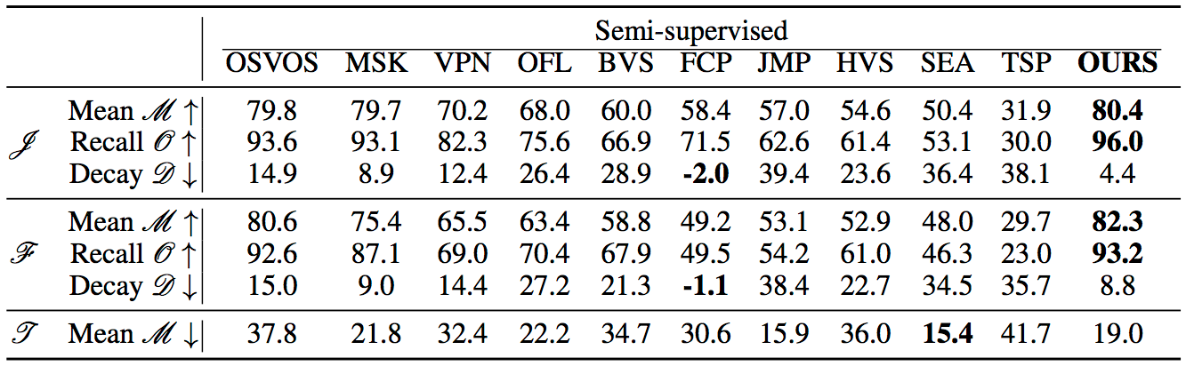
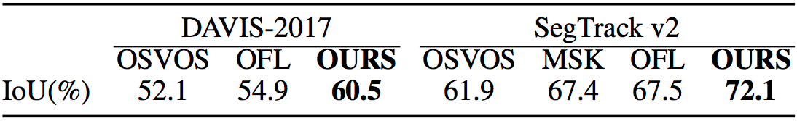
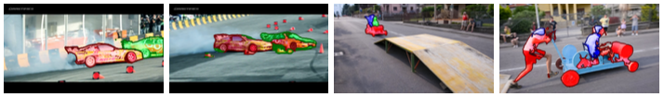
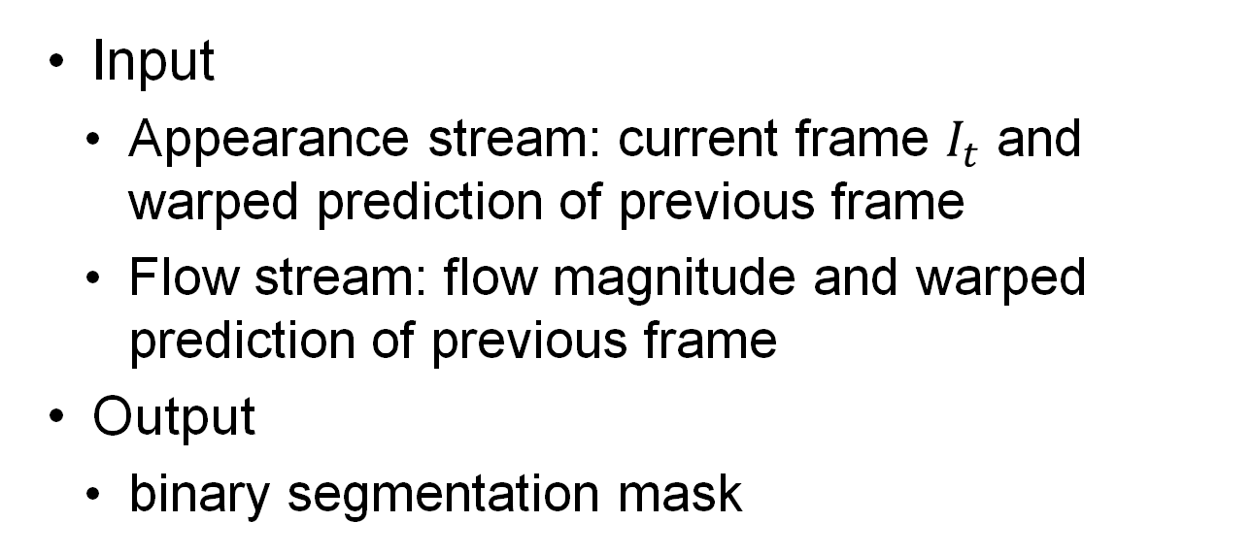
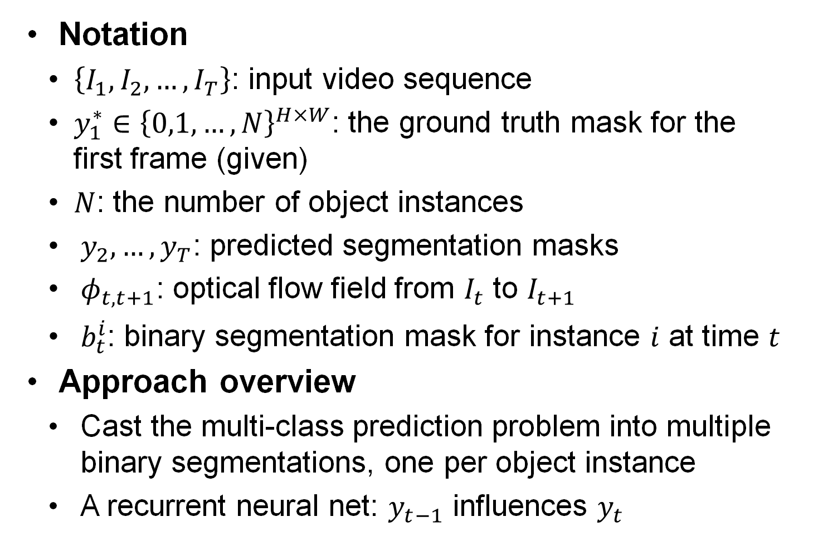
MaskRNN: Instance Level Video Object Segmentation
Yuan-Ting Hu¹, Jia-Bin Huang² and Alexander G. Schwing¹
¹ University of Illinois Urbana-Champaign, ² Virginia Tech
Yuan-Ting Hu Jia-Bin Huang Alexander G. Schwing
University of Illinois Urbana-Champaign
Virginia Tech
University of Illinois Urbana-Champaign
1. Introduction
2. MaskRNN - Overview
Instance level video object segmentation
Challenges: Occlusion, deformation, dynamic background
Contributions
MaskRNN, a recurrent neural net based approach for instance-level video object segmentation
Leverage long-term temporal information and the location prior
Object Localization Net
Notation
$\left\{I_{1},I_{2},…,I_{T}\right\}$: input video sequence
$y_{1}^{∗}∈{\left\{0,1,…,N\right\}}^{H×W}$: the ground truth mask for the first frame (given)
$N$: the number of object instances
$y_{2},…,y_{T}$: predicted segmentation masks
$φ_{t,t+1}$: optical flow field from $I_{t}$ to $I_{t+1}$
$b_{t}^{i}$: binary segmentation mask for instance $i$ at time $t$
Approach overview
Cast the multi-class prediction problem into multiple binary segmentations, one per object instance
A recurrent neural net: $y_{t−1}$ influences $y_{t}$
Binary Segmentation Net
3. MaskRNN – Binary Segmentation
4. Experimental Results
4.1
Ablation Study
4.3
Qualitative Results
Assess the performance of the individual components
3.1
Binary Segmentation Net
3.3
Training and Finetuning
4.2
Quantitative Results
Input
Appearance stream: current frame $I_{t}$ and warped prediction of previous frame
Flow stream: flow magnitude and warped prediction of previous frame
Output
binary segmentation mask
Trained end-to-end via back-propagation through time given a training sequence
Offline training
Step 1. Optimize the network on static images
Step 2. Further optimize the network using the recurrence relation
Online finetuning
Optimize the binary segmentation net and localization net based on the given ground truth
Comparisons with state-of-the-art on DAVIS-16 dataset
4.4
Failure Cases
3.2
Object Localization Net
Intersection over union on DAVIS-17 and Segtrack v2 dataset compared to state-of-the-art approaches
Similar appearance of instances of interest
Large variations in scale and viewpoint
Find the bounding box proposal on the warped prediction
Bounding box regression

